Slide 1
Computer Input/output System
2019
Instructors: Yang Quansheng
School of Computer Science and Engineering
College of Software Engineering
Southeast University

Slide 2
Chapter 6:
82C55 Programmable Peripheral Interface

Slide 3
Outline
Basic of 82C55
Structure and Pins of 82C55
82C55 Operation Mode
Programming the 82C55
Applications

Slide 4
6.1 Basic of 82C55
Compatible with all Intel and most other microprocessors
Completely TTL Compatible
Three 8-bit Ports
  Port A: One 8-bit output latch/buffer and/or one 8-bit data input latch
  Port B: One 8-bit output latch/buffer or one 8-bit data input latch
  Port C: One 8-bit output latch/buffer or one 8-bit data input buffer (no latch for input). This port can be divided into two 4-bits ports under the mode control. Each 4-bit port contains a 4-bit latch and it can be used for the control signal outputs and status signal inputs in conjunction with A and B.

Slide 5
6.1 Basic of 82C55
24 programmable I/O pins which may be individually programmed in 2 groups.
  Group A consisting of port A and upper part of port C.
  Group B consisting of port B and lower part of port C.
Three operation modes(Mode 0, 1, 2)
  Mode 0: Basic Input/Output
  Mode 1: Strobed Input/Output
  Mode 2: Bi-Directional Bus
Direct Bit Set/Reset Capability Easing Control Application Interface( Port C)

Slide 6
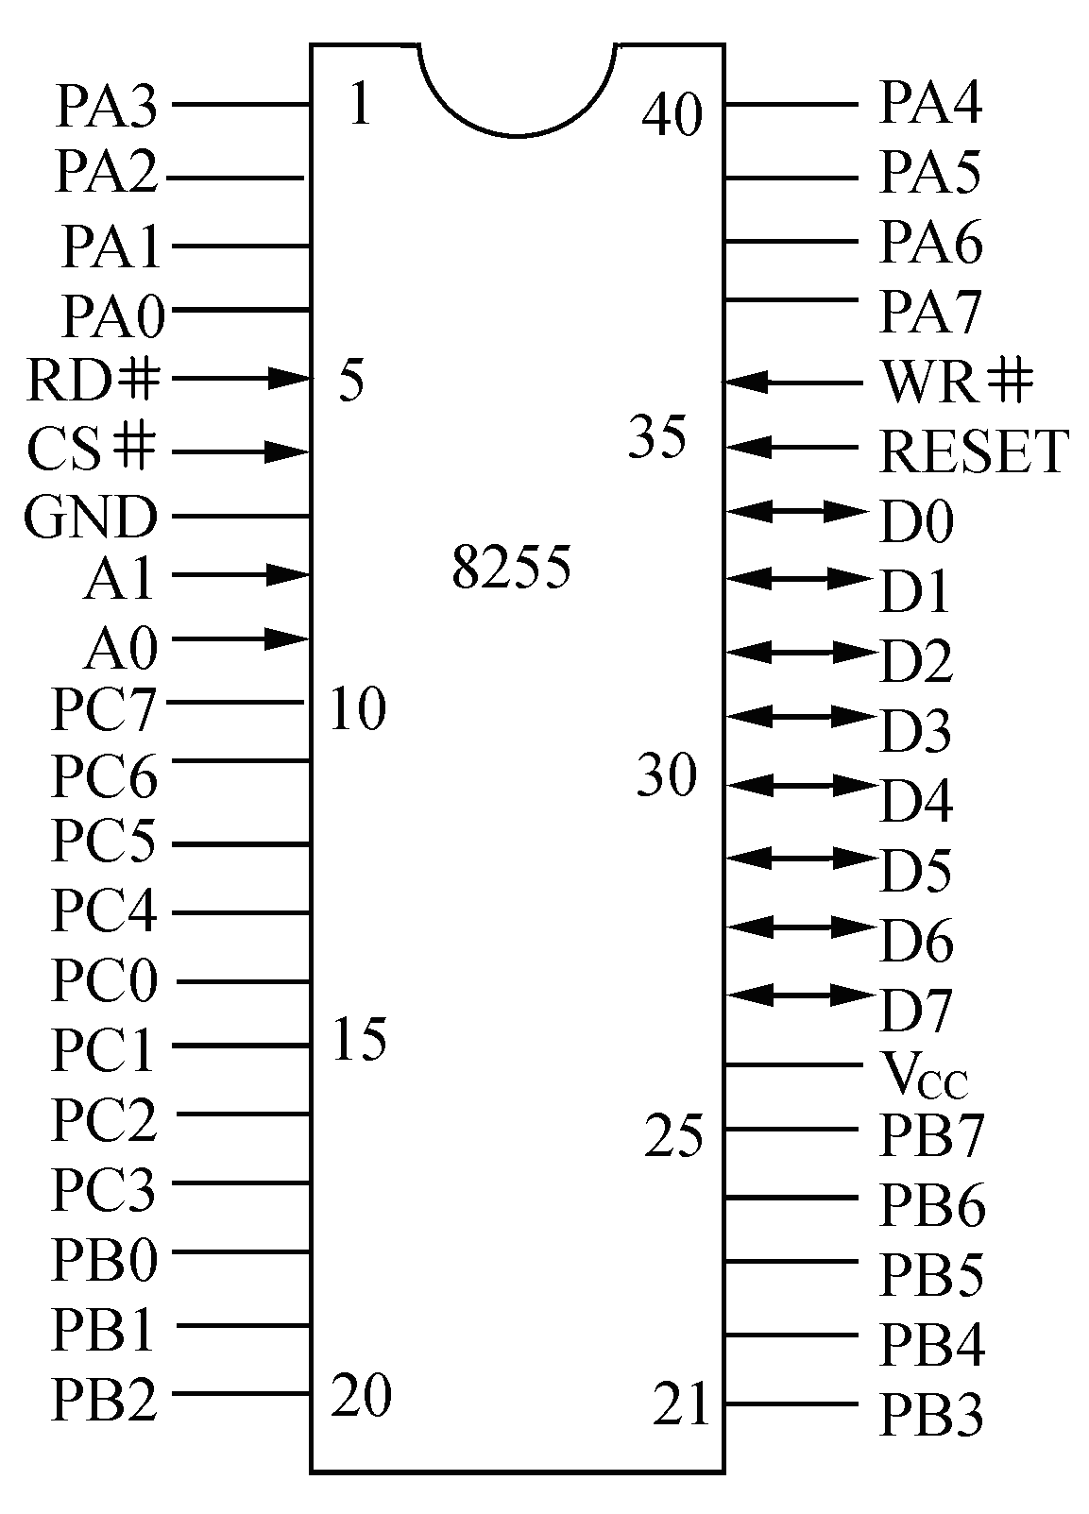
6.2 Structure and pins of 82C55
82C55 Pinout

Slide 7
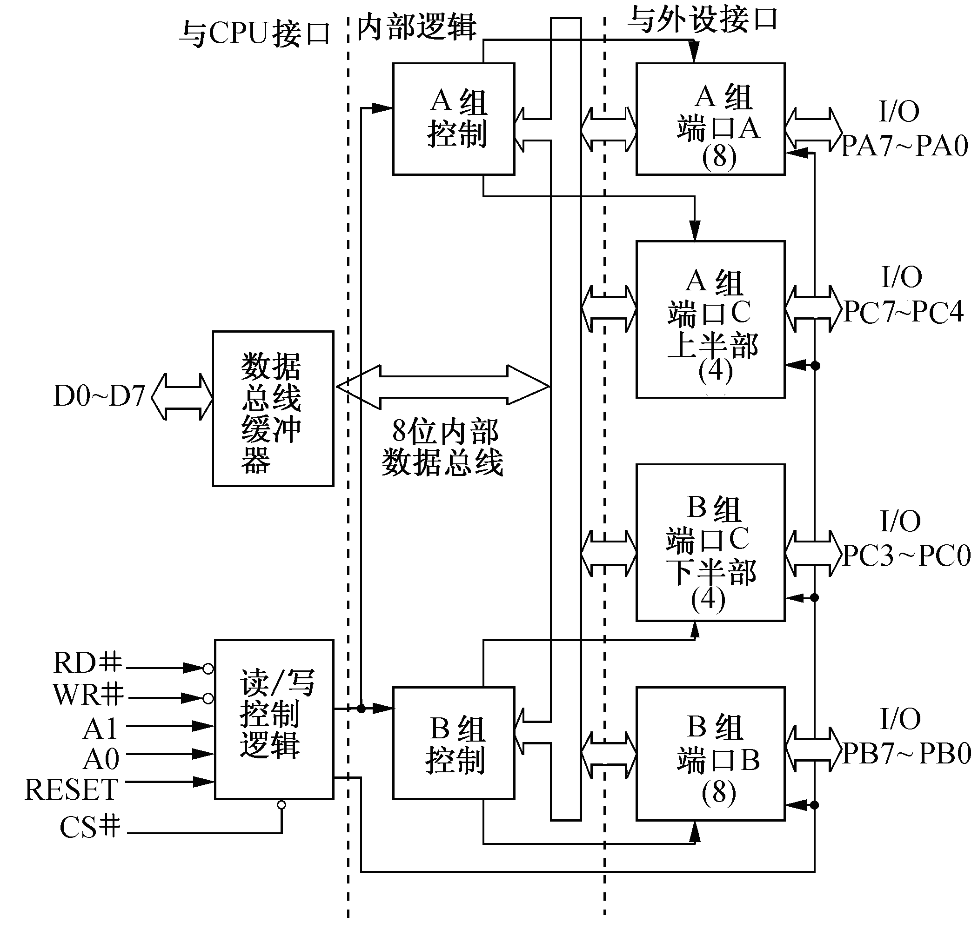
6.2 Structure and pins of 82C55
82C55 Block Diagram
Internal Logic
To Interface
To CPU(System BUS)
Group A
Control
Group A
Port A (8)
Group A
Port C
Upper (4)
Data
Bus
Buffer
8-bit
Internal
Data Bus
Group B
Port C
Lower (4)
Data
Bus
Buffer
Group B
Control
Group B
Port B (8)

Slide 8
6.2 Structure and pins of 82C55
82C55 Port and Operation
A1 | A0 | DR# | WR# | CS# | Operation | CHB
0 | 0 | 0 | 1 | 0 | Read: Port A → Data Bus | -
0 | 1 | 0 | 1 | 0 | Read: Port B → Data Bus | -
1 | 0 | 0 | 1 | 0 | Read: Port C → Data Bus | -
0 | 0 | 1 | 0 | 0 | Write: Data Bus → Port A | -
0 | 1 | 1 | 0 | 0 | Write: Data Bus → Port B | -
1 | 0 | 1 | 0 | 0 | Write: Data Bus → Port C | -
1 | 1 | 1 | 0 | 0 | Write: Data Bus → Control Word | D7=1
 |  |  |  |  | Write: Bit set/Reset to Port C | D7=0
X | X | X | X | 1 | Data Bus → 3-State | -
1 | 1 | 0 | 1 | 0 | Illegal Condition | -
X | X | 1 | 1 | 0 | Data Bus → 3-State | -

Slide 9
6.3 82C55 Operation Mode
Mode 0 – Basic Input/Output
  Two 8-bit ports and two 4-bit ports
  Any port can be input or output
  Outputs are latched
  Inputs are not latched
  16 different Input/Output configurations are possible in this Mode.
    A UPPER C B LOWER C
    OUTPUT OUTPUT OUTPUT OUTPUT
    OUTPUT OUTPUT OUTPUT INPUT
    OUTPUT OUTPUT INPUT OUTPUT
    OUTPUT OUTPUT INPUT INPUT
    …

Slide 10
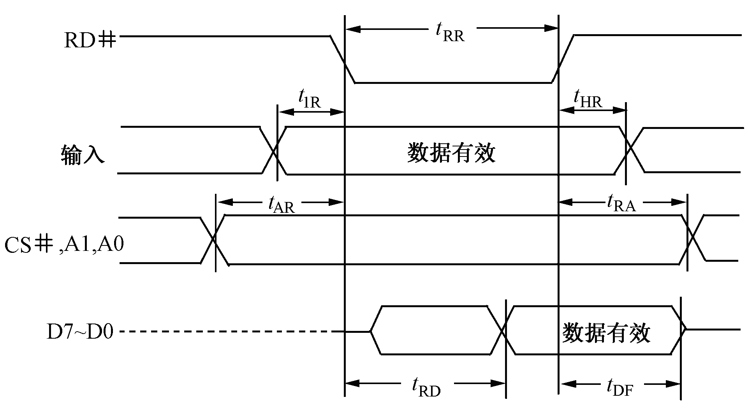
6.3 82C55 Operation Mode
Mode 0 – Basic Input/Output
INPUT
Data valid
Data valid
8255A Mode 0 Input

Slide 11
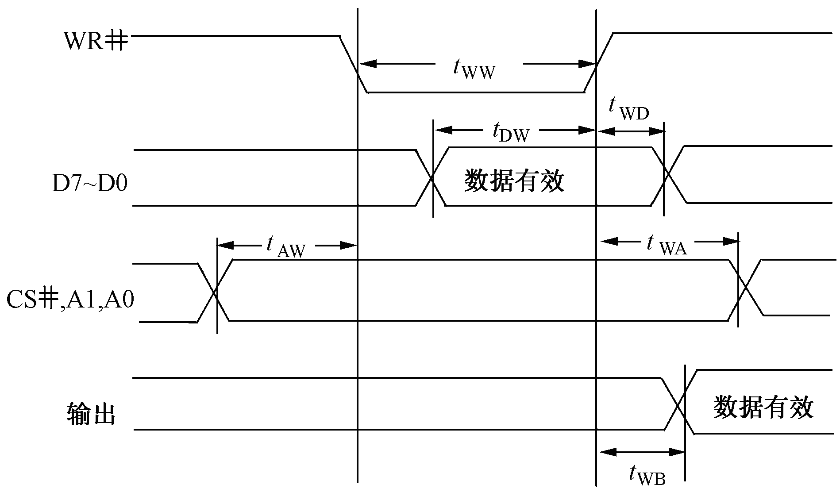
6.3 82C55 Operation Mode
Mode 0 – Basic Input/Output
Data valid
OUTPUT
Data valid
8255A Mode 0 Output

Slide 12
6.3 82C55 Operation Mode
Mode 1 – Strobed Input/Output
  Two Groups (Group A and Group B).
  Each group contains one 8-bit data port and one 4-bit control/data port.
  The 8-bit data port can be either input or output. Both inputs and outputs are latched.
  The 4-bit port is used for control and status of the 8-bit data port.

Slide 13
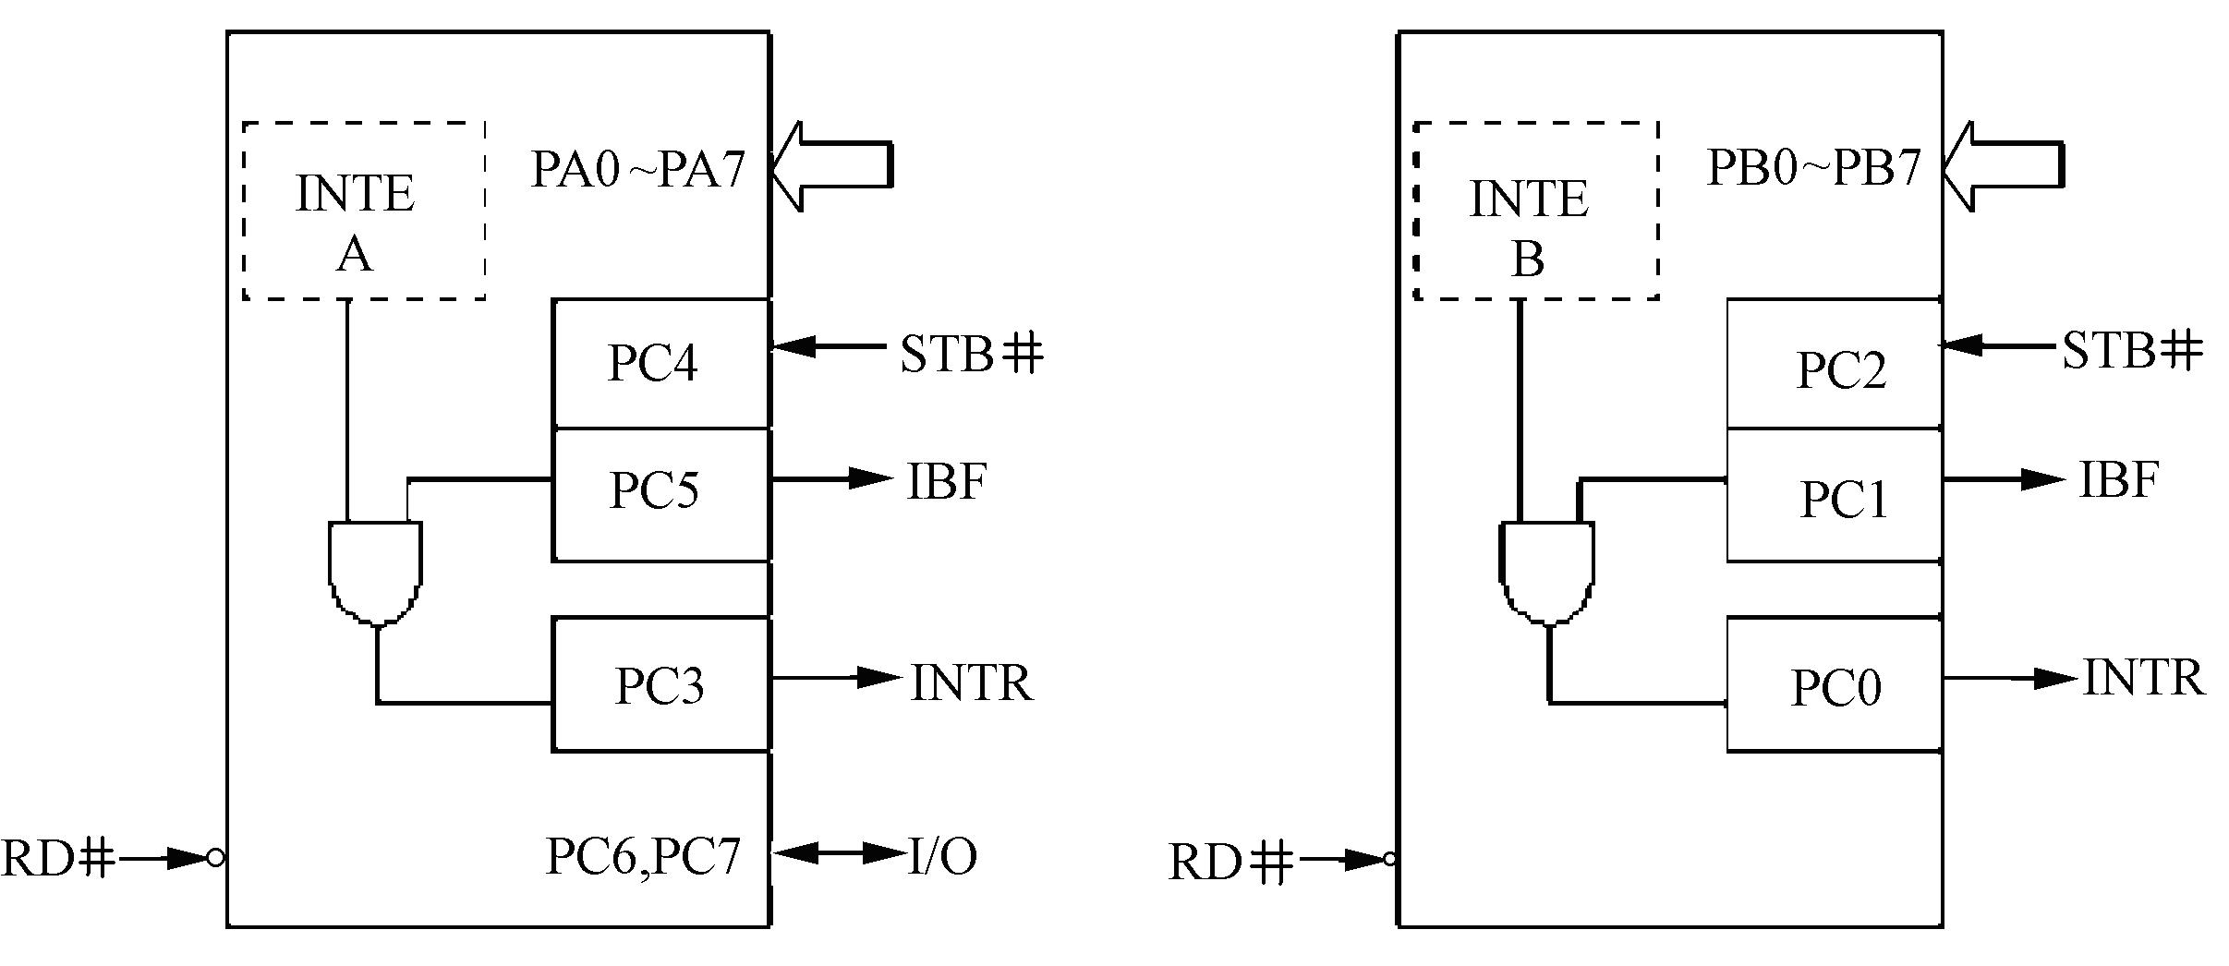
6.3 82C55 Operation Mode
Mode 1 – Strobed Input/Output
Group A Mode 1 input
Group B Mode 1 input

Slide 14
6.3 82C55 Operation Mode
Mode 1 – Strobed Input/Output
  STB#. A “low” on this input loads data into the input latch.
  IBF. A “high” on this output indicates that data has been loaded into the input latch; in essence, an acknowledgement. IBF is set by STB# input being low and is reset by the rising edge of the RD# input.
  INTR. A “high” on this output can be used to interrupt the CPU when an input device is requesting service. INTR is set by the STB# is a “one”, IBF is a “one” and INTE is a “one”. It is reset by the falling edge of RD#. This procedure allows an input device to request service from the CPU by simply strobing its data into the port.
  INTE A. Controlled by bit set/reset of PC4.
  INTE B. Controlled by bit set/reset of PC2.

Slide 15
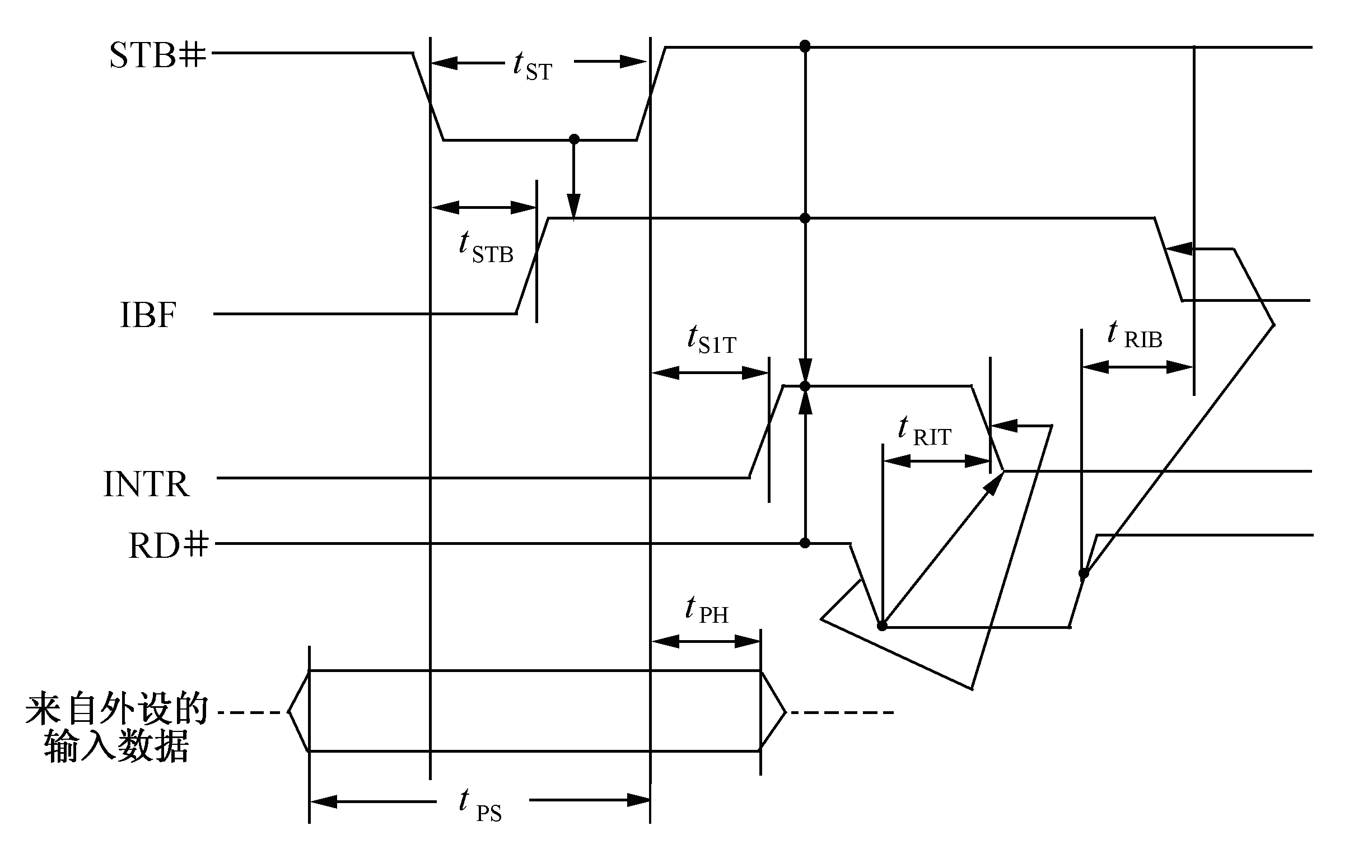
6.3 82C55 Operation Mode
Mode 1 – Strobed Input/Output
Data from
Peripheral
device

Slide 16
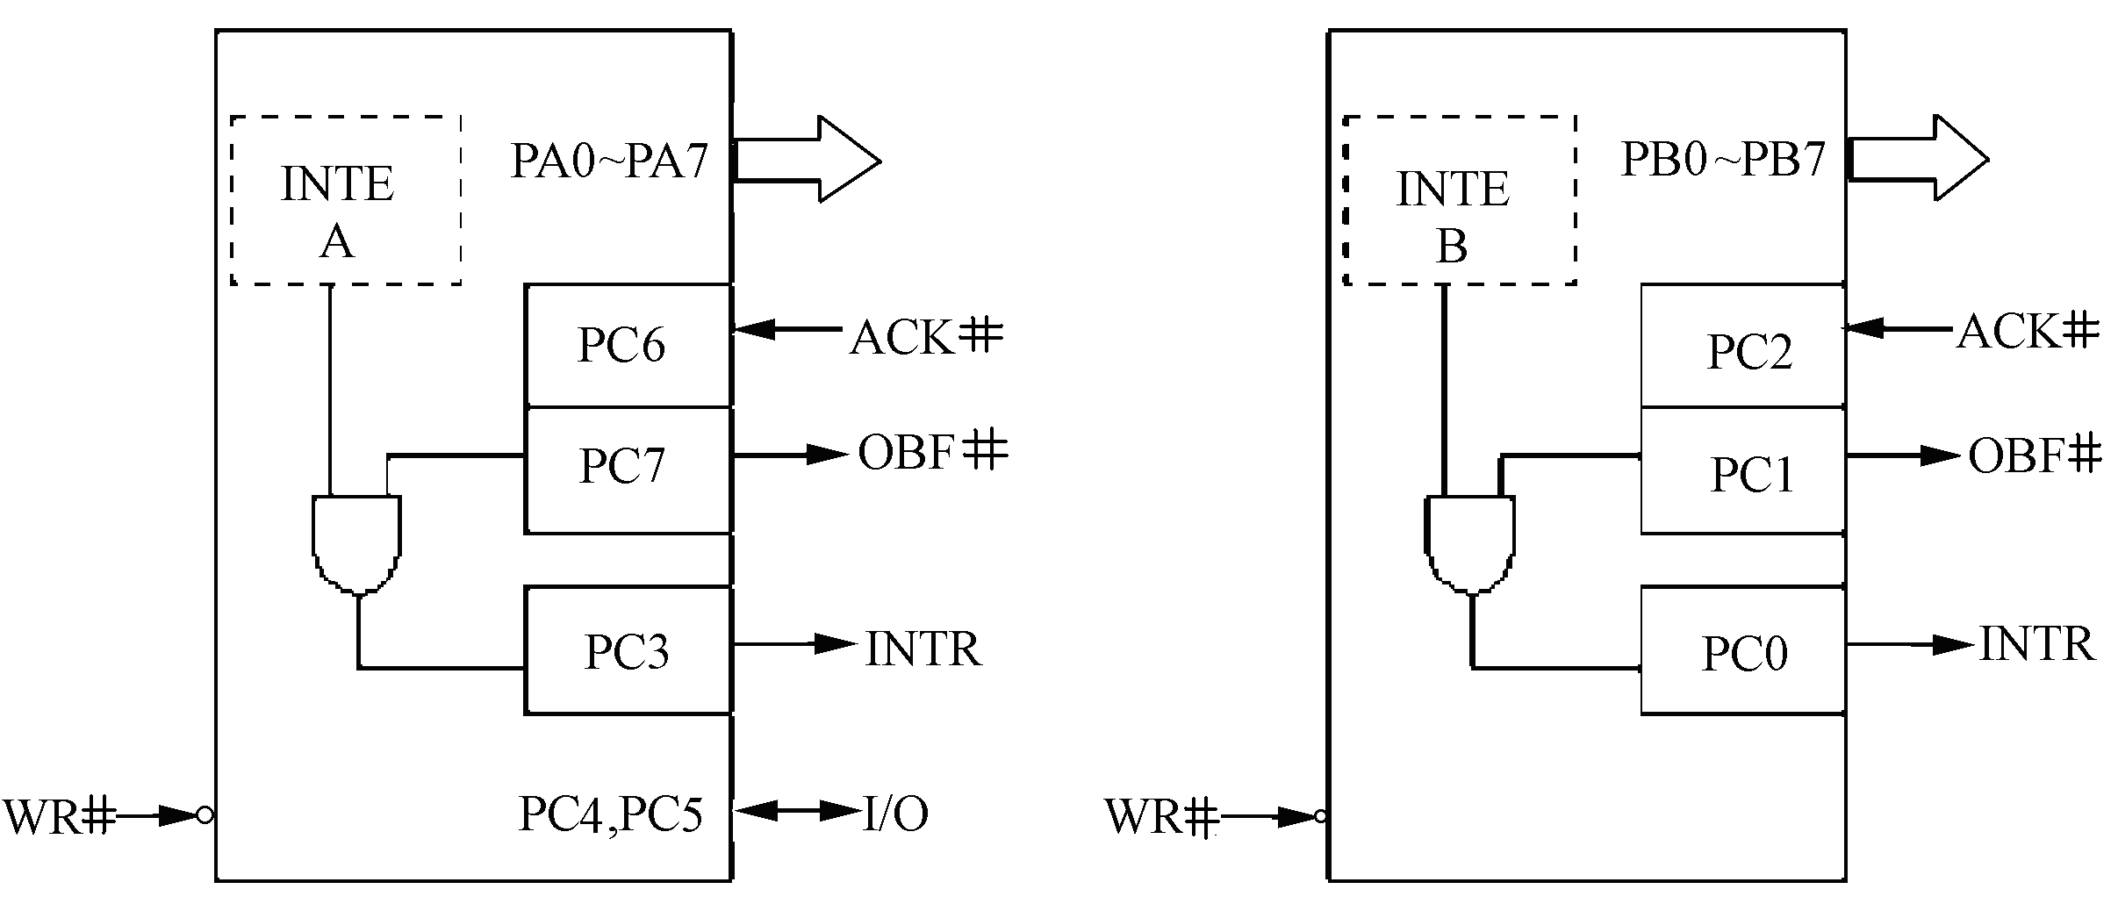
6.3 82C55 Operation Mode
Mode 1 – Strobed Input/Output
Group A Mode 1 output
Group B Mode 1 output

Slide 17
6.3 82C55 Operation Mode
Mode 1 – Strobed Input/Output
  OBF#. The OBF# output will go “low” to indicate that the CPU has written data out to the specified port. OBF# will be set by the rising edge of the WR# input and reset by ACK# input being low.
  AKC#. A “low” on this input informs the 8255A that the data from port A or port B has been accepted. In essence, a response from the peripheral device indicating that it has received the data output by the CPU.
  INTR. A “high” on this output can be used to interrupt the CPU when an output device has accepted data transmitted by the CPU. INTR is set when ACK# is a “one”, OBF# is a “one” and INTE is a “one”. It is reset by the falling edge of wWR#.
  INTE A. Controlled by bit set/reset of PC6.
  INTE B. Controlled by bit set/reset of PC2.

Slide 18
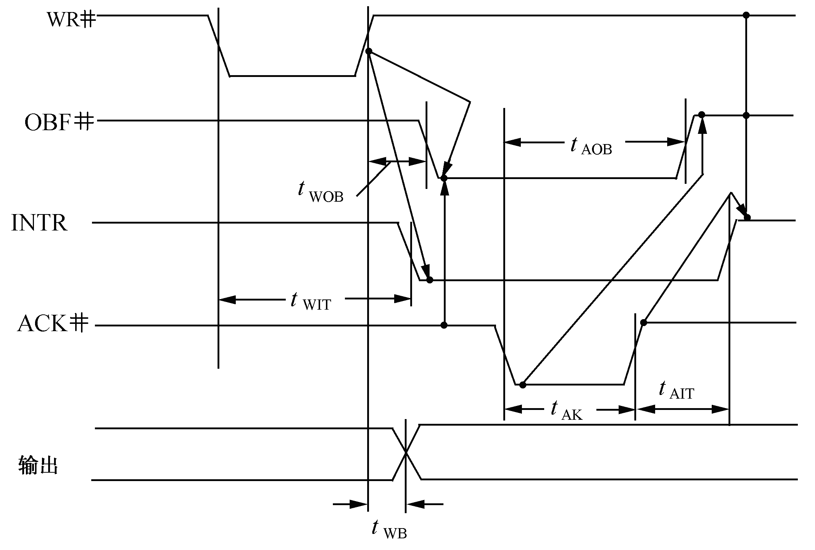
6.3 82C55 Operation Mode
Mode 1 – Strobed Input/Output
OUTPUT

Slide 19
6.3 82C55 Operation Mode
Mode 2 – Strobed Bidirectional Bus I/O
  Used in Group A only.
  One 8-bit, bi-directional bus Port (Port A) and a 5-bit control Port (Port C).
  Both inputs and outputs are latched.
  The 5-bit control port (Port C) is used for control and status for the 8-bit, bi-directional bus port (Port A).

Slide 20
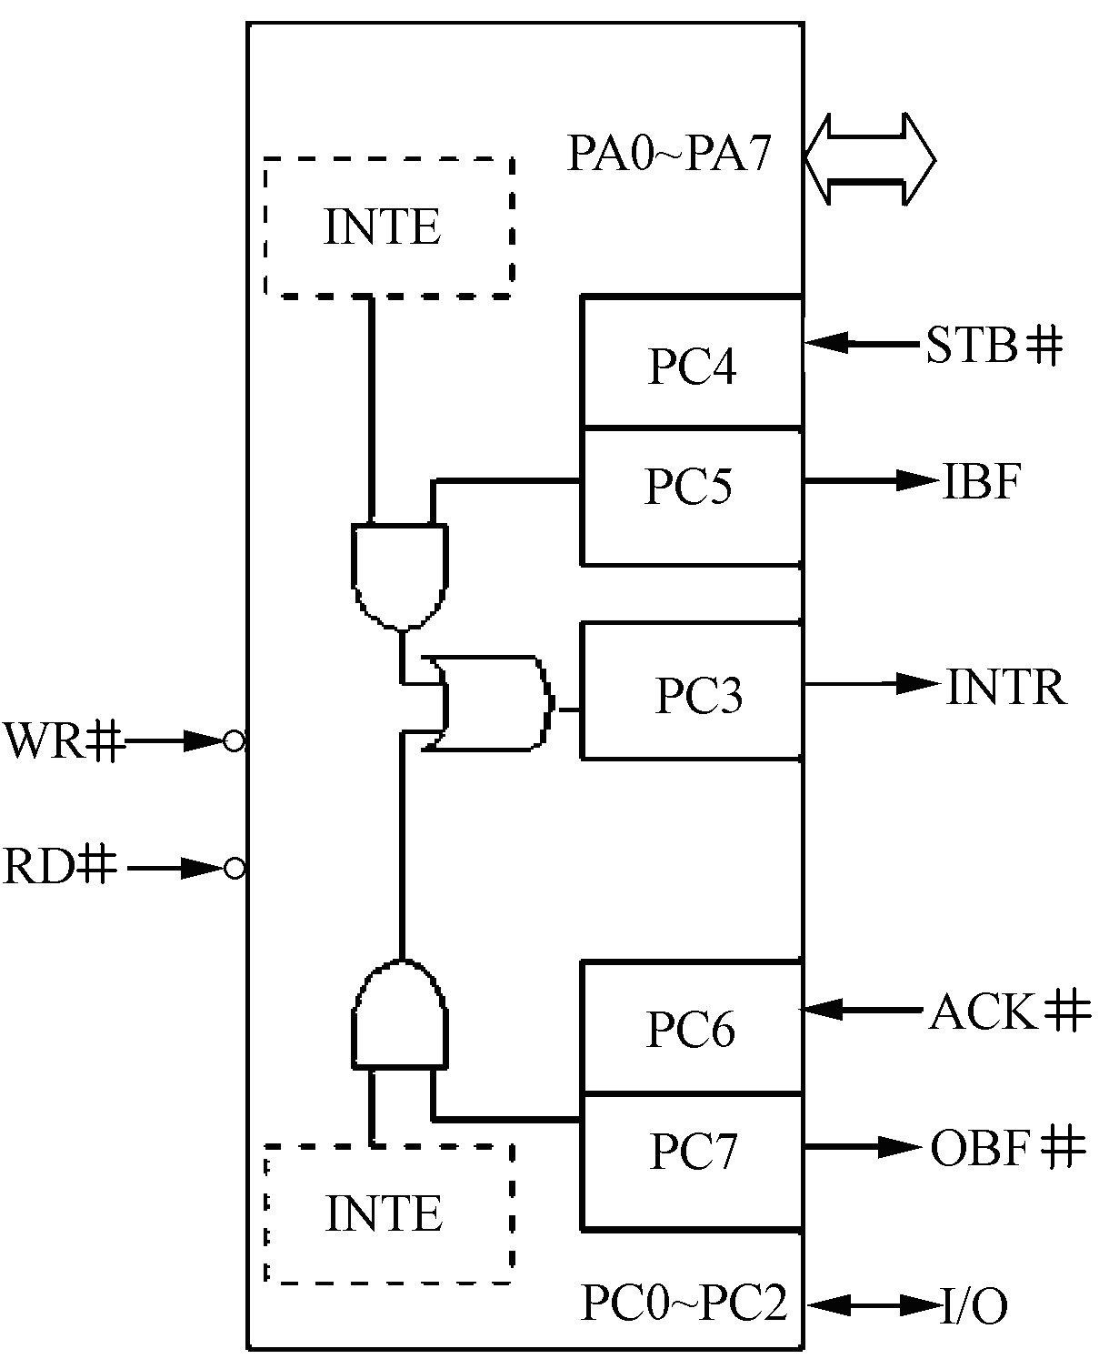
6.3 82C55 Operation Mode
Mode 2 – Strobed Bidirectional Bus I/O
INTE1
INTE2
Group A Mode 2

Slide 21
6.3 82C55 Operation Mode
Mode 2 – Strobed Bidirectional Bus I/O
  INTR. A “high” on this output can be used to interrupt the CPU for Both input or output operations.
  Output Operations
    OBF#. The OBF# output will go “low” to indicate that the CPU has written data out to Port A.
    ACK#. A “low” on this input enables the tri-state output buffer of port A to send out the data. Otherwise, the output buffer will be in the high impedance state.
    INTE 2. Controlled by bit set/reset of PC6
  Input Operations
    STB#. A “low” on this input loads data into the input latch.
    IBF. A “high” on this output indicates that data has been loaded into the input latch.
    INTE 1. Controlled by bit set/reset of PC4

Slide 22


6.4 Programming the 82C55
Control Word
  Write only (A1A0=11)
D7 | D6 | D5 | D4 | D3 | D2 | D1 | D0
FLAG=1 | Group A Mode 00=Mode 0 01=Mode 1 1X=Mode 2 |  | Port A 0=output 1=input | Port C Upper 0=output 1=input | Group B Mode 0=Mode 0 1=Mode 1 | Port B 0=output 1=input | Port C Lower 0=output 1=input
e.g. In one system, the Address of 82C55 is 60H~63H, Port A in mode 1, input, Port B in mode 0, output, Port C upper part as input, lower as output, please write the Control word.
MOV AL，0B8H ; 10111000B
OUT 63H，AL

Slide 23
6.4 Programming the 82C55
Bit set/reset
  Port C only (A1A0=11)
D7 | D6 | D5 | D4 | D3 | D2 | D1 | D0
FLAG=0 | Don’t care |  |  | Port C Bit select 000=bit 0 001=bit 1 … 111=bit 7 |  |  | 1 = set 0 = reset
e.g. In the example above , how to enable the interrupt for Port A? (Set PC4 = 1)
MOV AL，00001001B
OUT 63H，AL

Slide 24
6.5 Application
e.g. An application use 82C55 to collect the status of a switch S₇~S₀, then display the status of switches through a set of light-emitting diodes(LED₇~LED₀) ( when S_{i} closed, the lED_{i} bright). Look the circuit below, suppose that both Group in 8255 are in mode 0.
What is the port address of 82C55?
What is the control word?
Programming the 82C55

Slide 25
6.5 Application
LED₇
D₇~D₀
D₇~D₀
PA₇
WR#
WR#
LED₀
RD#
RD#
PA₀
A₉
G₁
Y₀ #
CS#
AEN
G₂A#
A₈
8255A
74LS138
A₇
&
A₆
G₂B#
S₇
A₅
PB₇
A₄
C
A₃
B
S₀
A₂
A
PB₀
A₁
A₁
A₀
A₀

Slide 26
6.5 Application
The Port address of this 82C55 is:
320H、321H、322H和323H。
Port A – mode 0, output，Port B – mode 0, input, so Control Word is 10000010b＝82H
3) MOV AL, 82H ;write control word
MOV DX, 323H ;
OUT DX, AL
L1: MOV DX, 321H ;
IN AL, DX ;input switches state
NOT AL ;
MOV DX, 320H ;
OUT DX, AL ;output
JMP L1

Slide 27


6.5 Application
Thinking that:
If the requirements of the previous question is modified as: not use query, but an interrupt comes every 50ms, in the interrupt handler, read port B and write port A.
How to modify the circuit and program? Suppose that the system provides a 2KHz pulse, 8254 and 8259 address are the same as PC.

Slide 28

6.5 Application
e.g. Now connect the printer with 82C55 port A in mode 0. Programming to print the char in BUFF
When STB# is valid, the printer receive the data, when BUSY is valid, means the printer is busy now, can’t receive the data.

Slide 29
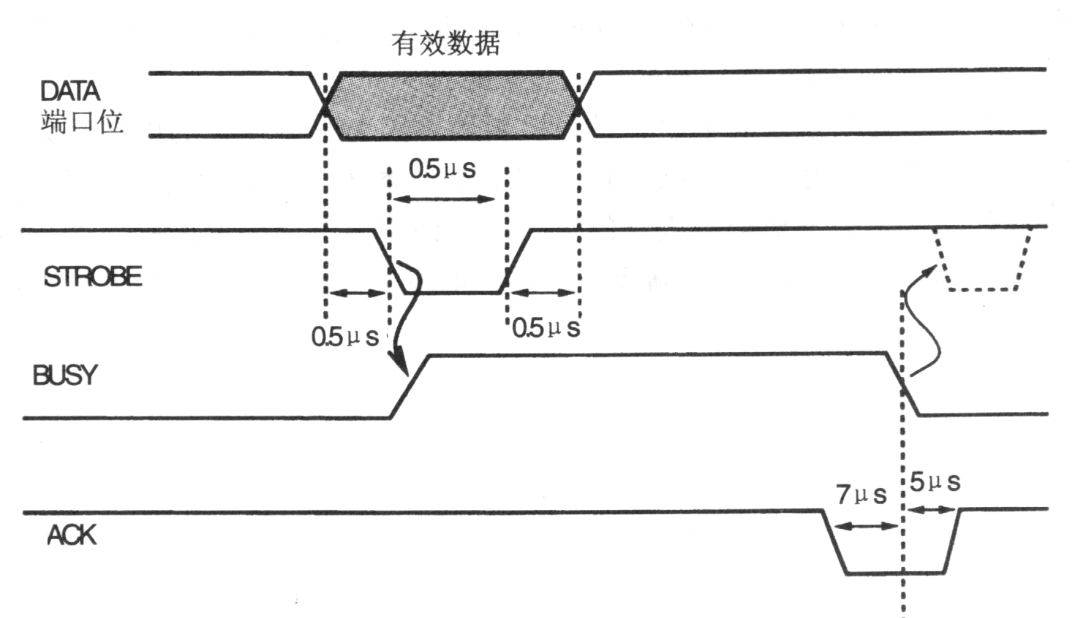
6.5 Application
#
#

Slide 30
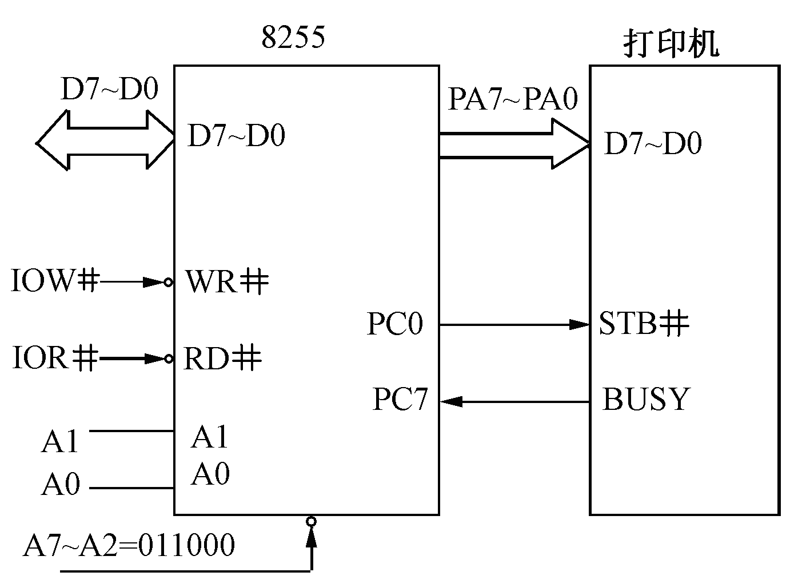

6.5 Application
printer

Slide 31
6.5 Application
.DATA
BUFF BYTE ‘HELLO,WORLD!’, 13, 10, ‘$’
PORTA EQU 60H
PORTB EQU 61H
PORTC EQU 62H
PORTCN EQU 63H
.CODE
START： MOV AX，@DATA
MOV DS，AX
MOV SI，OFFSET BUFF

Slide 32
6.5 Application
; initial 8255, Port A mode 0, output, Port C upper is input, lower is output
MOV AL，88H
OUT PORTCN，AL
MOV AL，01H ; set PC0，STB invalid
OUT PORTCN，AL
WAIT：IN AL，PORTC ; read status of printer
TEST AL，80H ; if “busy”, wait
JNZ WAIT
MOV AL，[SI]
CMP AL，‘$’
JZ PRINT_OVER

Slide 33
6.5 Application
OUT PORTA, AL ; sent the data
MOV AL, 00H
; generate the STB#
OUT PORTCN ,AL
MOV AL,01H
OUT PORTCN ,AL
INC SI
JMP WAIT
PRINT_OVER: MOV AH,4CH
INT 21H
END START

